Slide 1

Resume Screening Using Machine Learning
Final Project Presentation
Ahsan Habib
Date: 07 May, 2025

Slide 2
Problem Statement & Objectives
Manual screening risks unconscious bias affecting fairness.
HR spends 23 hours weekly on resume screening (SHRM, 2023).
Poor candidate fit leads to high employee turnover.
Objectives: Increase fairness, accuracy, speed, and reduce costs.
Bias in Screening
Time Inefficiency
Turnover Impact
Human judgment can unintentionally favor certain groups.
Manual processes slow down recruitment cycles and waste effort.
Unfit hires cause disruptions and increased costs for companies.

Slide 3
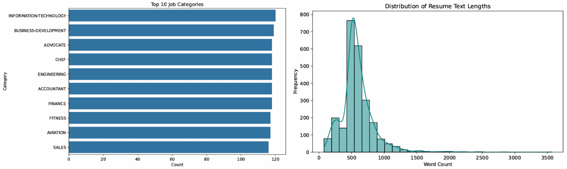
Dataset and Report Summary
On the left side we can see Horizontal bar chart, which shows the Frequency of Job Categories, On the Right we can see have create a histogram with Kernel density Estimate (to smoothen Distribution Curve) using Seaborn, which reveals skewness, central tendency and outliers.

Slide 4
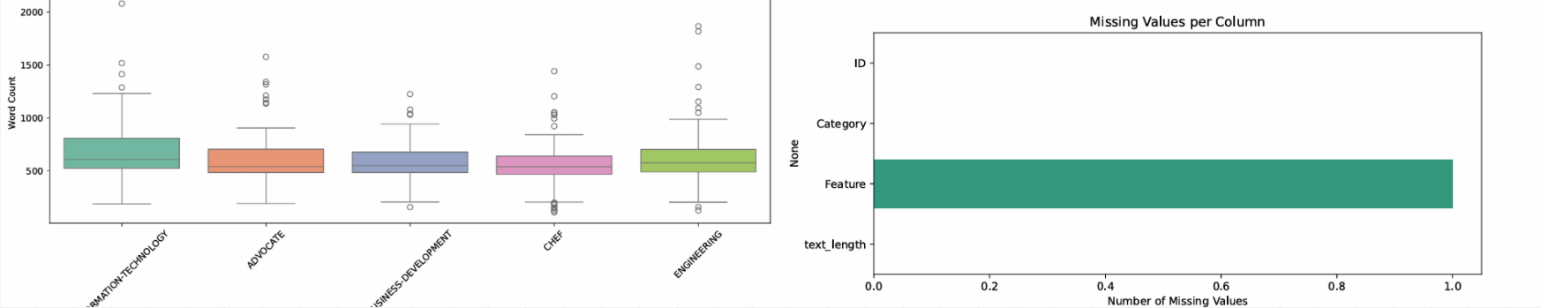
Dataset and Report Summary
We have also added a box plot and a missing value bar plot, by using Seaborn, to help visualize the dataset better, The Box plot on the left side, helps to detect the median, outliers and quartiles of the length of Long-texts. The graph on the right shows us the frequency distribution of Missing values, which Helps us to Understand the missing Columns across all variables.

Slide 5
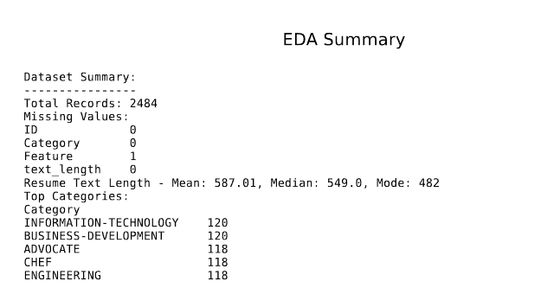
Dataset and Resport Summary

Slide 6

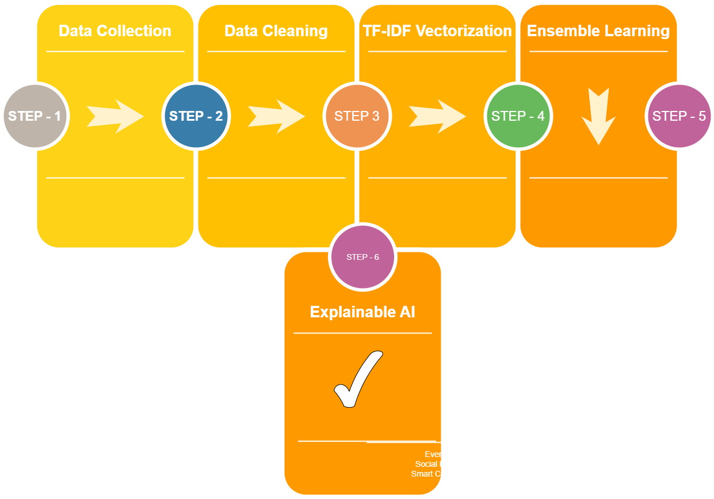



Methodology
Data Collection
Data Cleaning
TF- IDF Vectorization
Ensemble Learning
Explainable AI

Slide 7
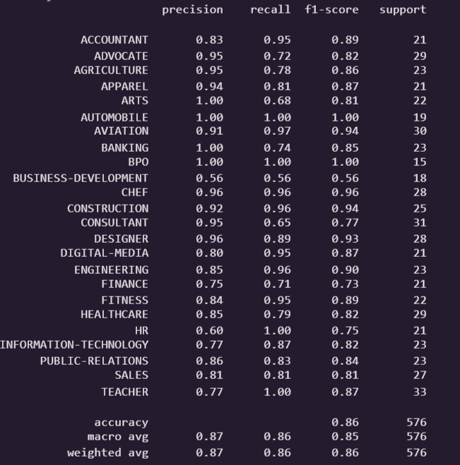
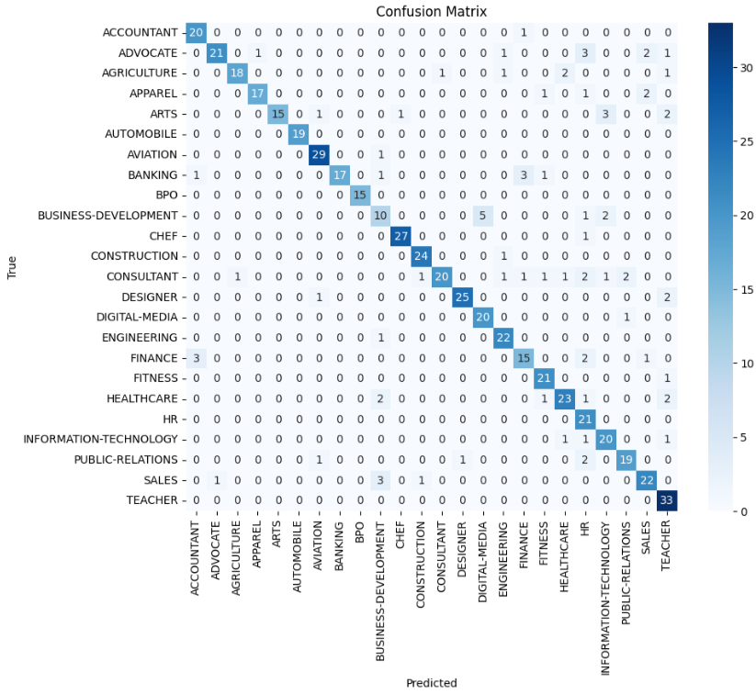
Accuracy and Confusion Matrix Based on Random Forest Classifier
Model : By using Random Forest Classifier

Slide 8
Future work
To enhance the model's accuracy and fairness, future work may involve several directions:
Integrating Deep Learning: Exploring the use of transformer-based models such as BERT or RoBERTa to capture contextual understanding of resume content.
Bias Detection and Mitigation: Implementing fairness-aware algorithms and conducting regular bias audits to ensure equity across different demographic groups.
User Feedback Loop: Including recruiter feedback in the learning pipeline to continuously refine model predictions based on human evaluation.
Multi-label Classification: Extending the task to predict multiple suitability categories (e.g., job fit, cultural fit) rather than a binary outcome.
Deployment and Usability: Developing an interactive dashboard or API that enables recruiters to upload and screen resumes with interpretable results.

Slide 9
THANK YOU EVERYONE

